Slide 1
Delivery Backdoor using Evilgarde Fake Update

Slide 2
Motivation and solution
Users won’t click suspicious links that contain backdoors
Solution
Attacker injects a backdoor to popular executable programs
Winzip, virtualbox, skype, etc.,
Attacker sends users a fake update link that users are more likely to click the link
The link contains the executable program with the backdoor embedded
Victim clicks the link and update the program
Both programs are running on victim’s machine
Backdoor runs on the background

Slide 3
How it works
Technical details

Slide 4



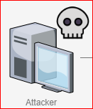
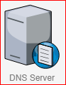
DNS SPOOFING
Malicious website
10.0.2.14
3. http:// 10.0.2.14
204.52.129.211
1. What is IP of ubalt.edu
2. ubalt.edu has IP 10.0.2.14
(spoofed DNS response)
MITM attack
Ubalt.edui | 10.0.2.14
3. http:// 10.0.2.14
Malicious website
(VirtualBox fake updates server using evilgrade)
10.0.2.14
DNS SPOOFING
4. Winzip fake updates
204.52.129.211
1. What is IP of ubalt.edu
2. ubalt.edu has IP 10.0.2.14
(spoofed DNS response)
MITM attack
Ubalt.edui | 10.0.2.14

Slide 5
Evilgrade tool
https://github.com/infobyte/evilgrade
Evilgrade is a modular framework that allows the user to take advantage of poor upgrade implementations by injecting fake updates.
It comes with pre-made binaries (agents), a working default configuration for fast pentests
It has it's own WebServer and DNSServer modules. Easy to set up new settings, and has an autoconfiguration when new binary agents are set.

Slide 6
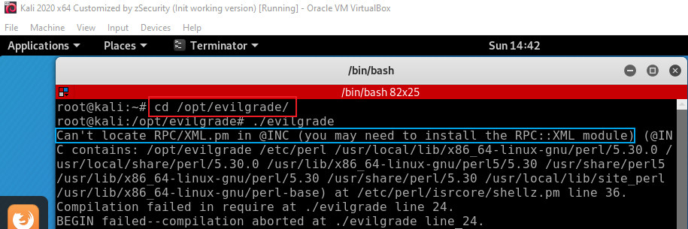
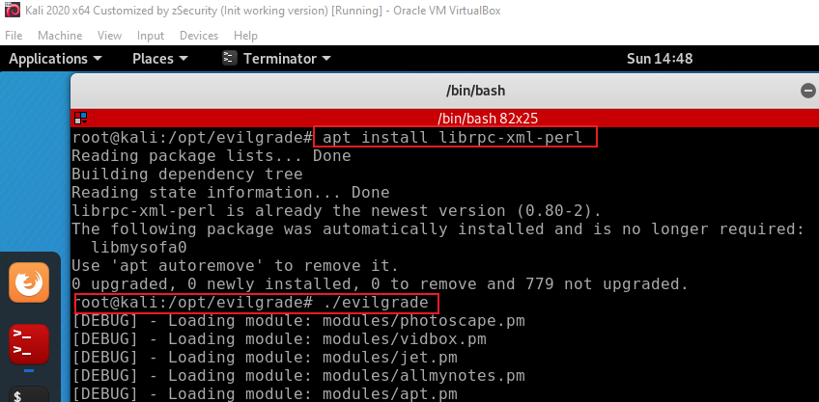
evilgrade troubleshooting for Kali 2020

Slide 7
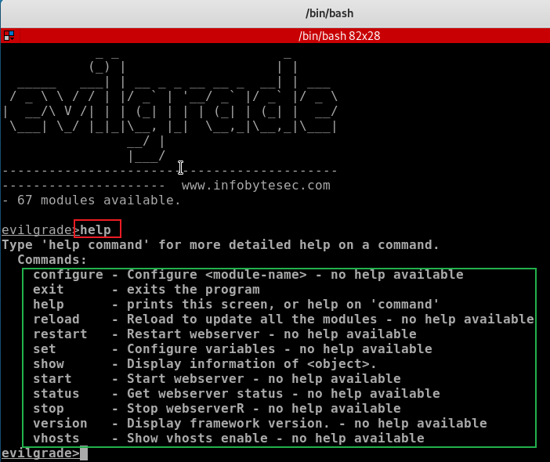
Help function

Slide 8
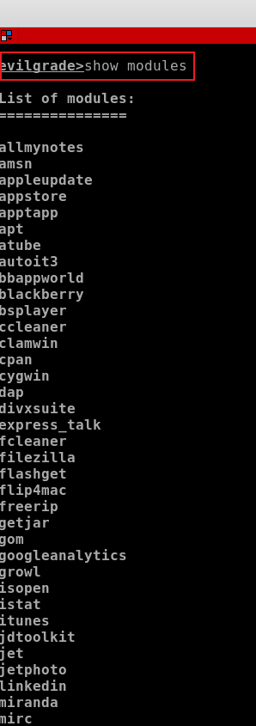
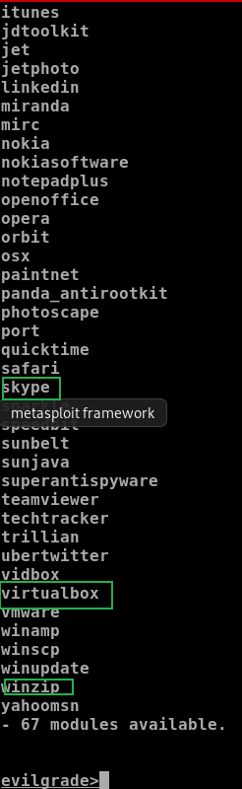
List implemented modules

Slide 9
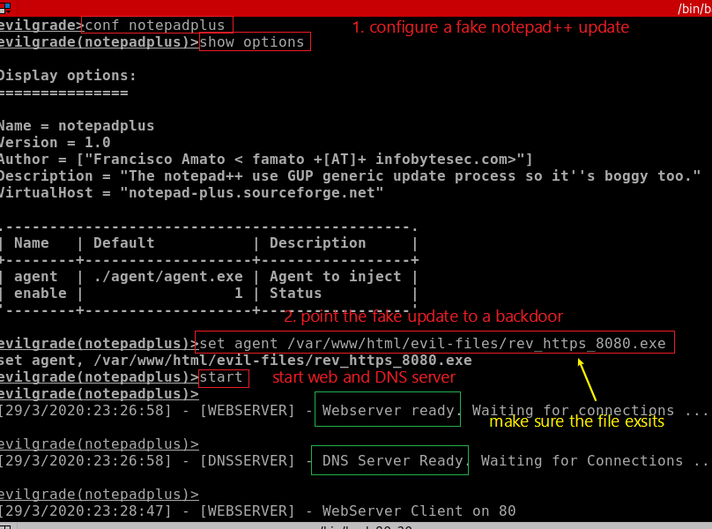
Configure a specified module
fake update link you will use it later

Slide 10
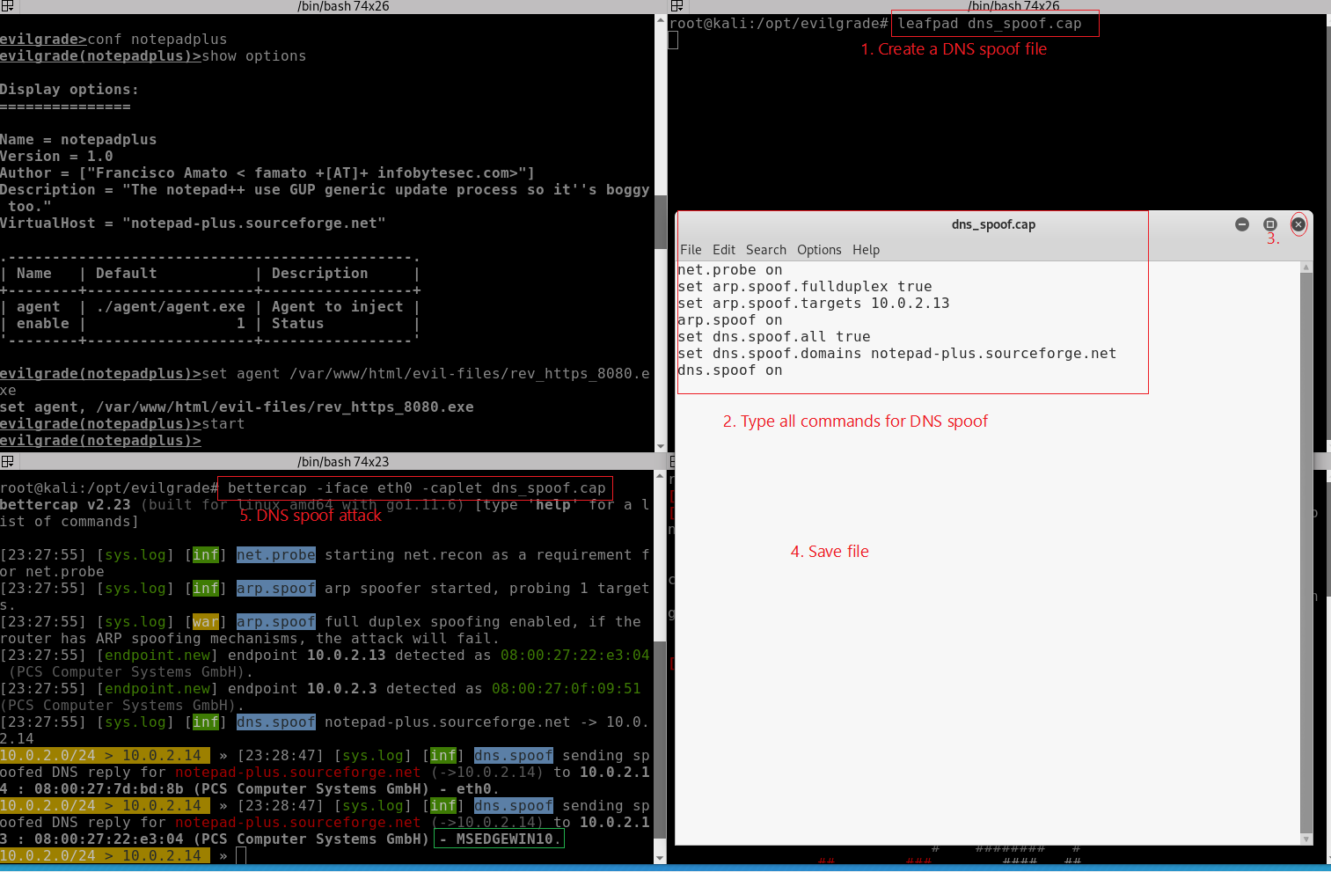
Create a caplet for DNS spoof and run
Save it

Slide 11
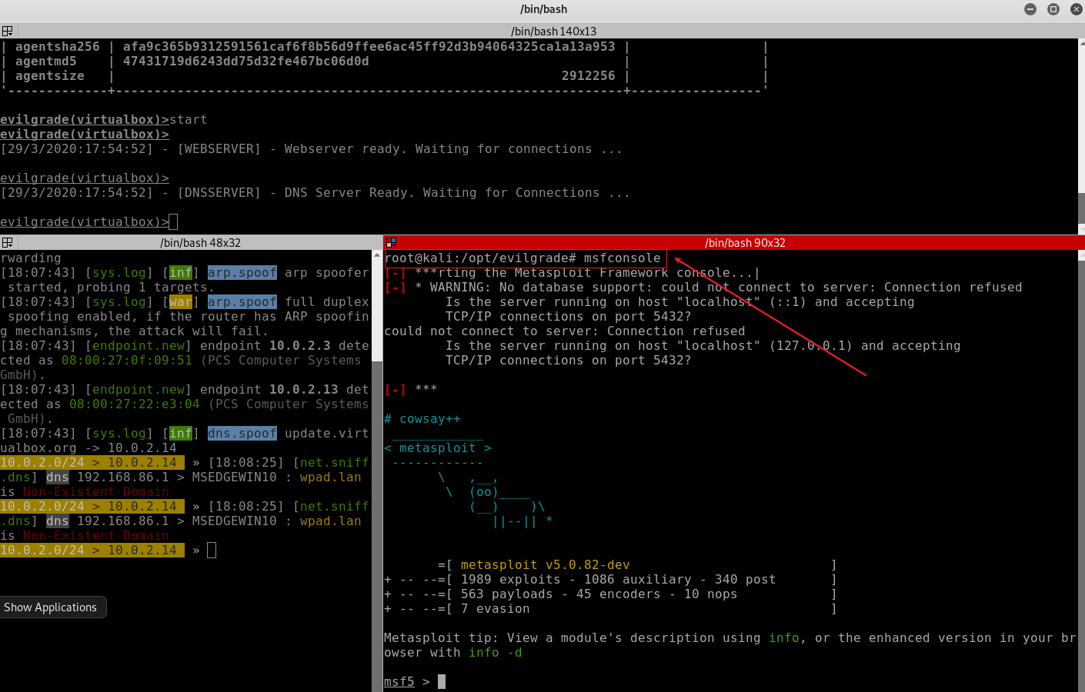
Start msfconsole to create a command center

Slide 12
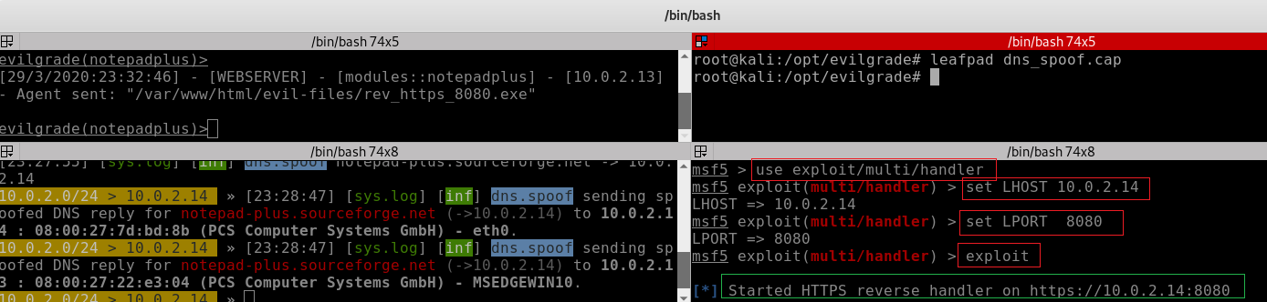
Launch handler/listener

Slide 13
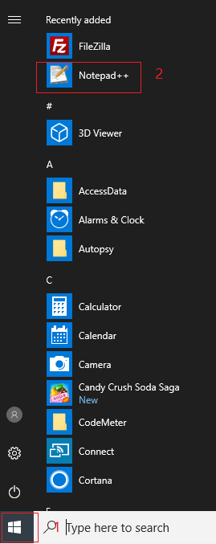
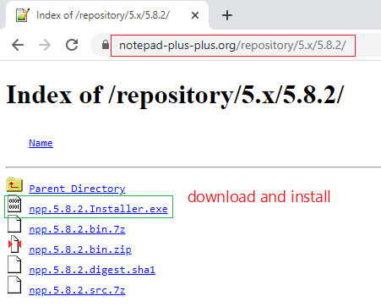
Download notepad 5.8.2
Victim PC

Slide 14
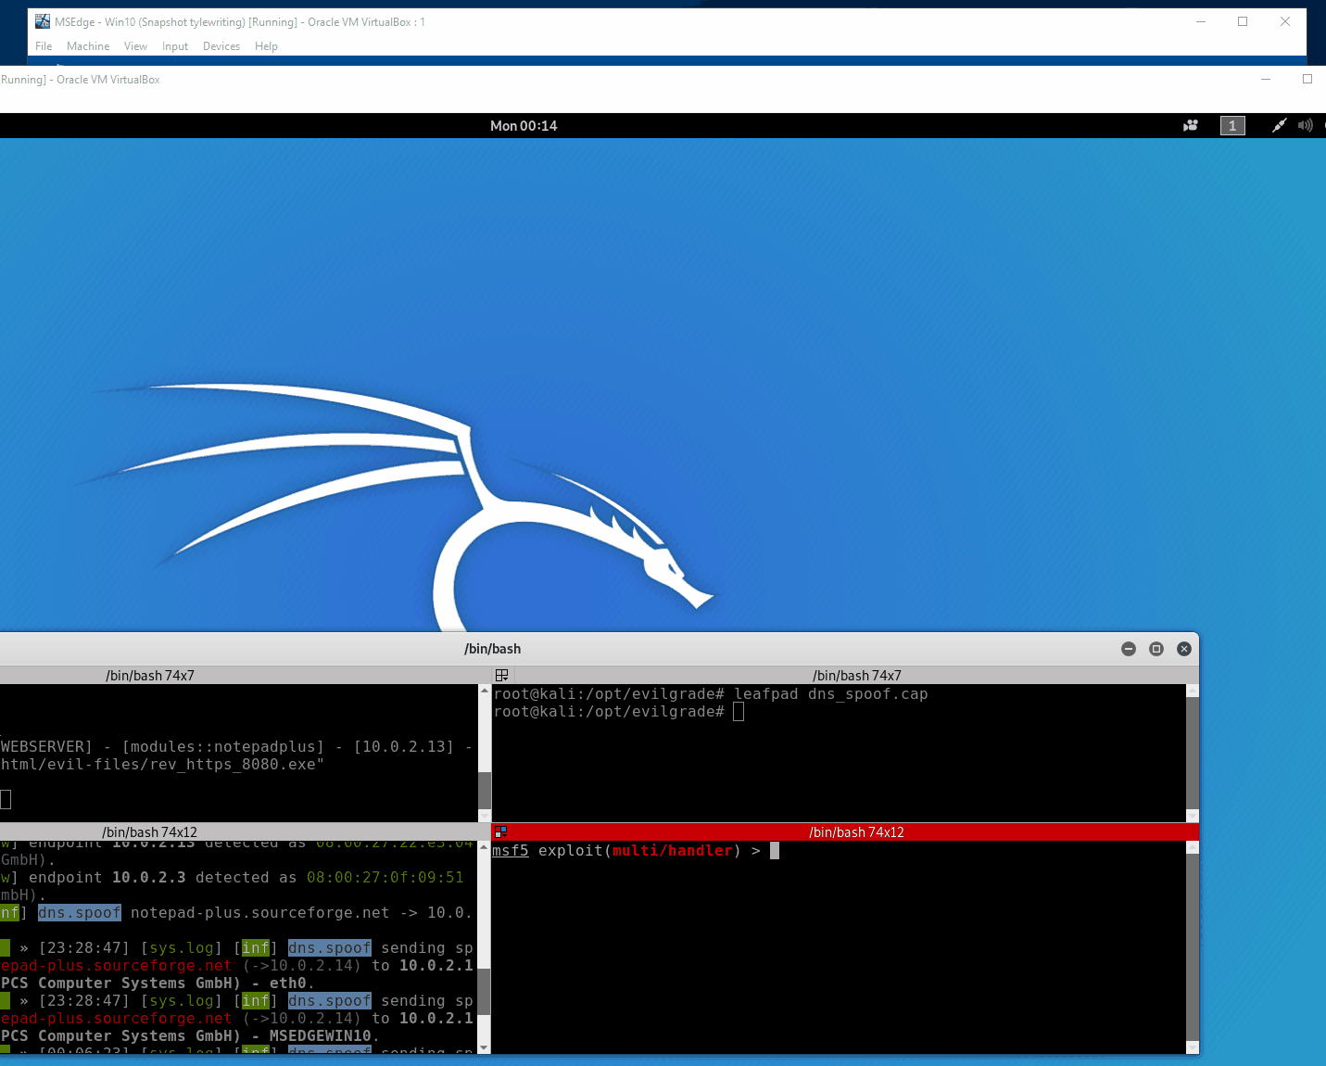
Animated results

